Slide 1


Slide 2
PROBLEM STATEMENT
Introduction of Problem :-
Intel Corporation wants to improve its product development and customer satisfaction by analyzing online reviews of its products.
Understanding customer sentiment from these reviews can provide valuable insights into product performance, customer satisfaction, and areas needing improvement.
Objectives:-
Develop a sentiment analysis model that can accurately classify online reviews of Intel products as positive, negative, or neutral
Identify key themes and trends in customer feedback, such as performance, price, quality, and customer support
Provide insights to Intel product teams to inform product development and improvement.
Enhance customer satisfaction by addressing concerns and improving overall customer experience.
Challenges:-
Handling the large volume and variability of online reviews
Dealing with noisy or biased data.
Identifying subtle nuances in customer sentiment and opinions.
Keeping up with changing customer preferences and trends.

Slide 3
EXPECTED OUTCOMES
.
Outcomes:-
comprehensive analysis of customer sentiment towards Intel products.
Identification of key product features driving positive or negative sentiment.
Visualization of sentiment trends and feature-specific insights.
Data-driven recommendations for product improvements and customer satisfaction enhancement
Data Collection:-
Collect online reviews from various sources (Amazon, Newegg, Best Buy, Intel's website, etc)
Use web scraping techniques or APIs to gather review data.
Store reviews in a database or CSV files.
Data Processing:-
Clean and preprocess review text data
Remove special characters, punctuation, and stop words
Tokenize text into individual words or phrases
Convert all text to lowercase
Remove duplicates and irrelevant reviews (e.g., non-English reviews)
Sentiment Analysis:-
Train a machine learning model for sentiment analysis:
Use a supervised learning approach (e.g., Naive Bayes, Support Vector Machines, Random Forest)
Train the model on a labeled dataset (positive, negative, neutral)
Use techniques like:
Bag-of-Words (BoW)
Term Frequency-Inverse Document Frequency (TF-IDF)
Word Embeddings (e.g., Word2Vec, GloVe)

Slide 4
EXPECTED OUTCOMES
Model Evaluation
Evaluate the sentiment analysis model
Use metrics like accuracy, precision, recall, F1 score, and AUC-ROC
Compare performance across different models and techniques
Theme Identification:-
Identify key themes and trends in customer feedback
Use techniques like
Topic Modeling (e.g., Latent Dirichlet Allocation, Non-Negative Matrix Factorization)
Named Entity Recognition (NER)
Part-of-Speech (POS) tagging
Extract insights on product features, performance, pricing, and customer support
Visualization and Insights:-
Visualize sentiment analysis results and theme identification insights
Use dashboards, bar charts, word clouds, and heatmaps
Provide actionable recommendations to Intel product teams
Share insights with stakeholders to inform product development and improvement

Slide 5
OVERVIEW OF STATEMENT
Tools And Technologies:-
Programming languages: Python, R
Libraries and frameworks: NLTK, spaCy, scikit-learn, TensorFlow, Keras
Databases: MySQL, MongoDB
Visualization tools: Tableau, Power BI, Matplotlib, Seaborn.
Benefits:-
Improved product development and customer satisfaction
Enhanced customer experience and loyalty
Increased competitiveness and market share
Data-driven decision-making for Intel product teams

Slide 6
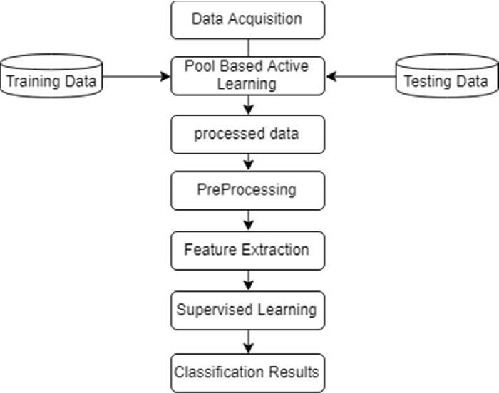
PROCESS FLOW

